Slide 1
Job Scheduling Algorithms in Big Data
Kunal Dhande A20369862
Mohit Kulpe A20372614

Slide 2
Introduction
Big data - data management systems that can manage large volume, velocity and variety of data
Hadoop allows to store and process big data in a distributed environment with asymmetrical clusters of computers using simple programming models.
A single node failure doesn’t affect the ruinous system failure.

Slide 3
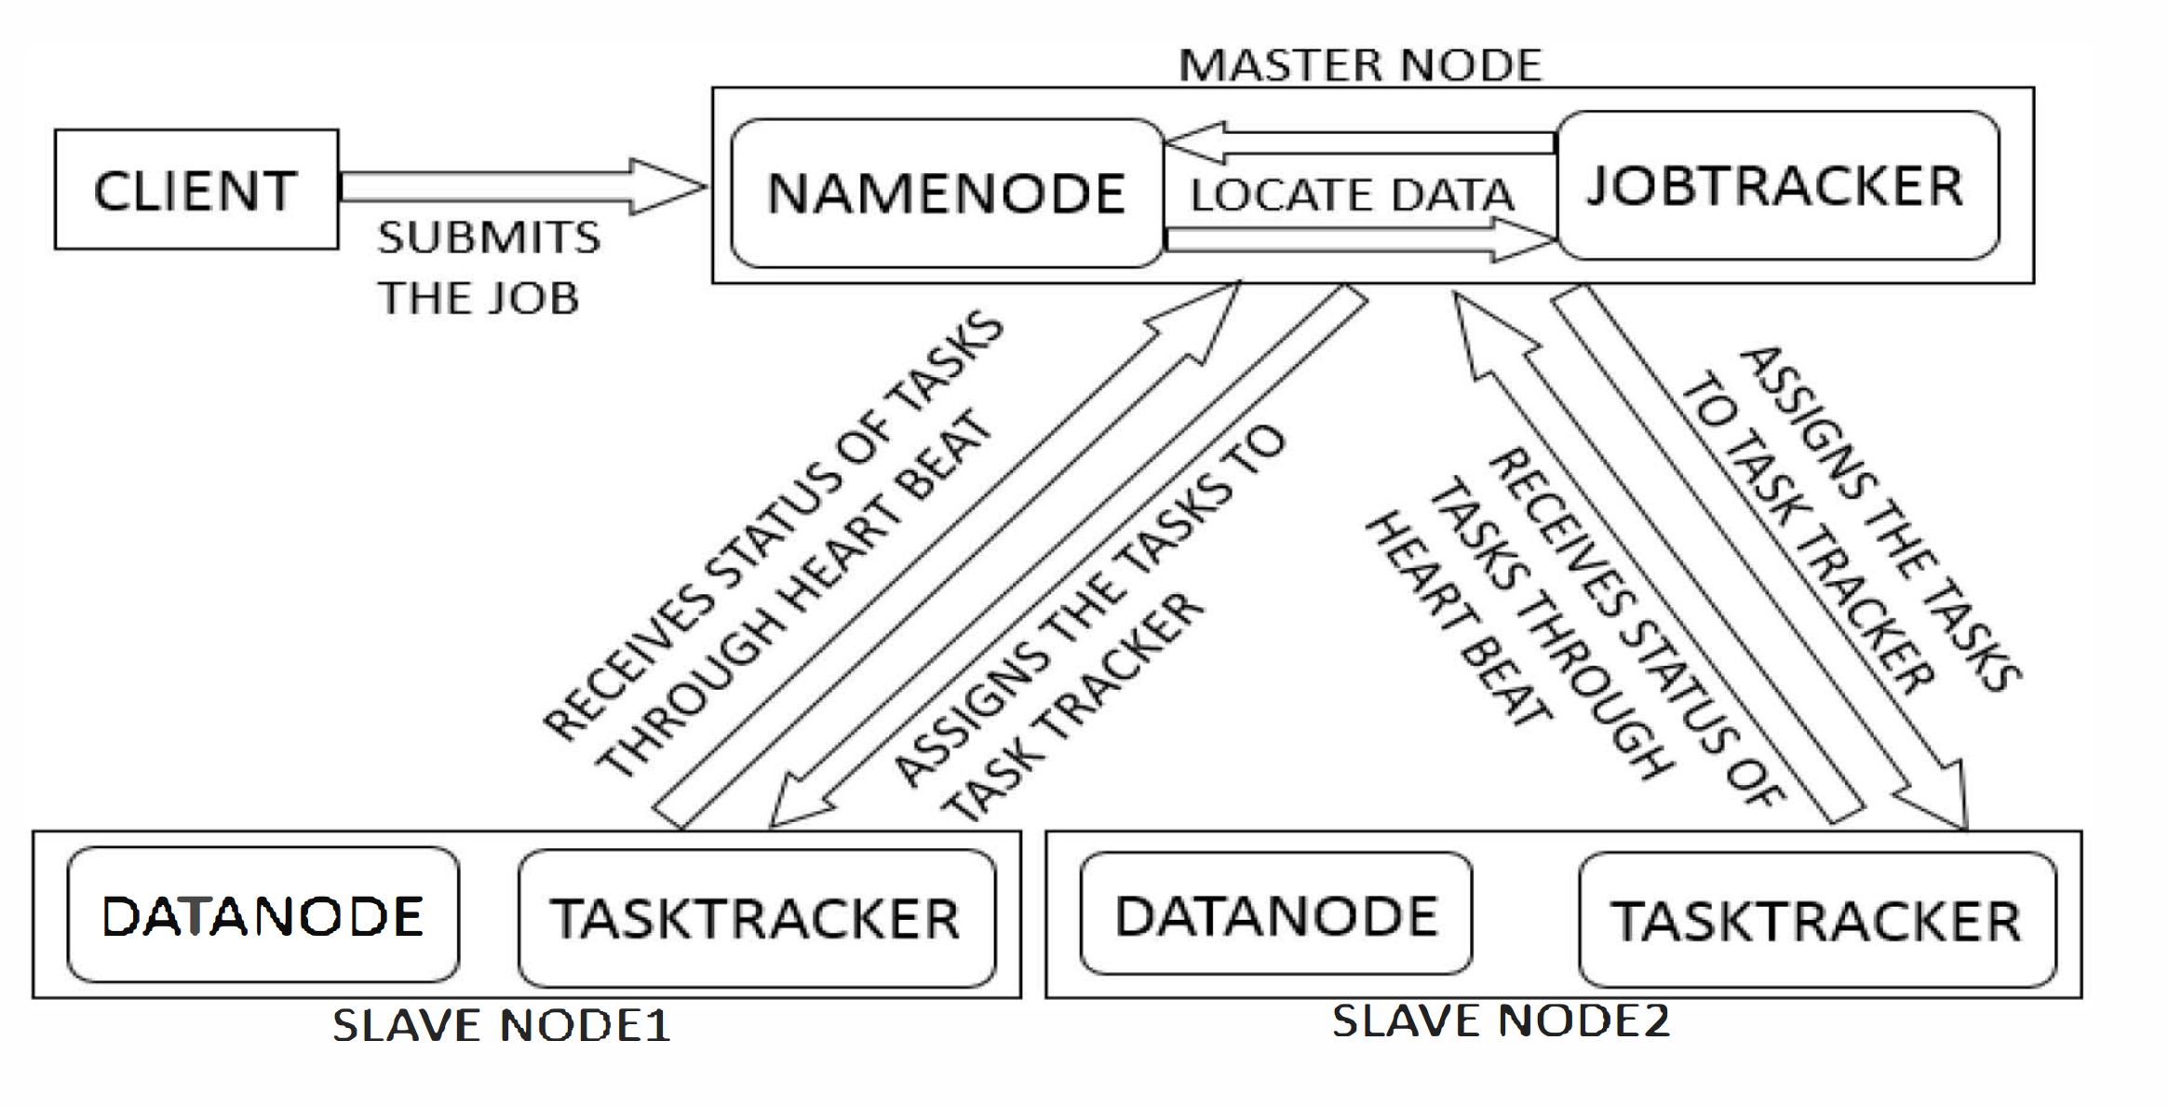
Hadoop Working

Slide 4
Issues in Scheduling
Locality
Distance between input data node and the task node
Synchronization
Process of transferring intermediate outputs of the Map processes as the input of the Reduce processes
Fairness
Refers to how fair a scheduling algorithm is for dividing the resources among users

Slide 5
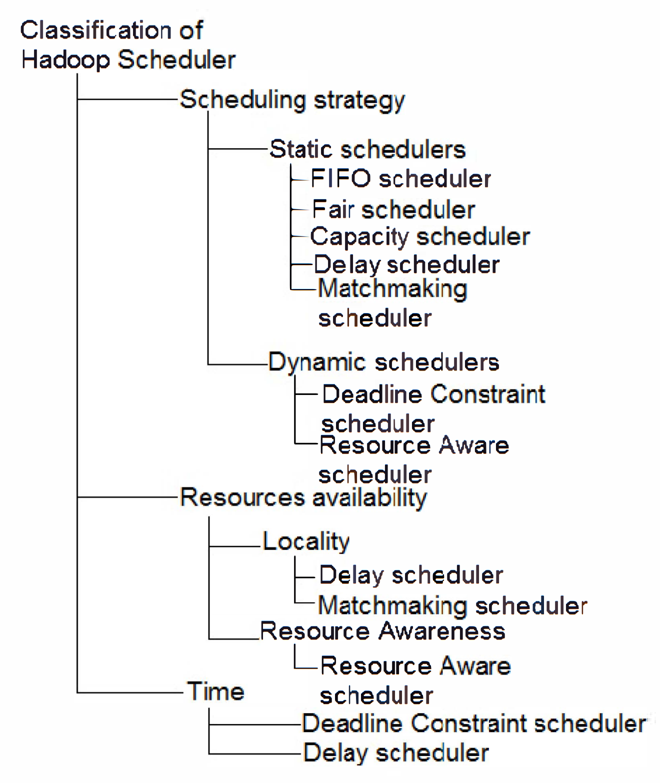
Classification Of Hadoop Scheduler

Slide 6
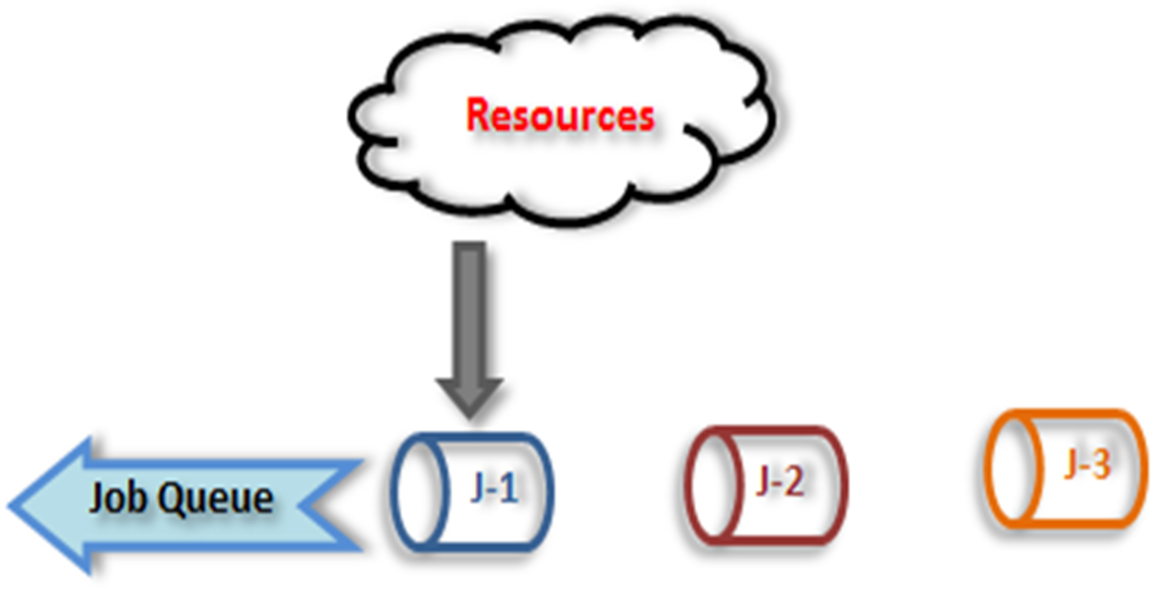
FIFO Scheduler
FIFO - First In First Out .
Jobs submitted earlier gets preference over jobs submitted later.
Does not consider priority or size of the Job.
Next job executed after execution of Previous job.
Used when Execution order is important.

Slide 7
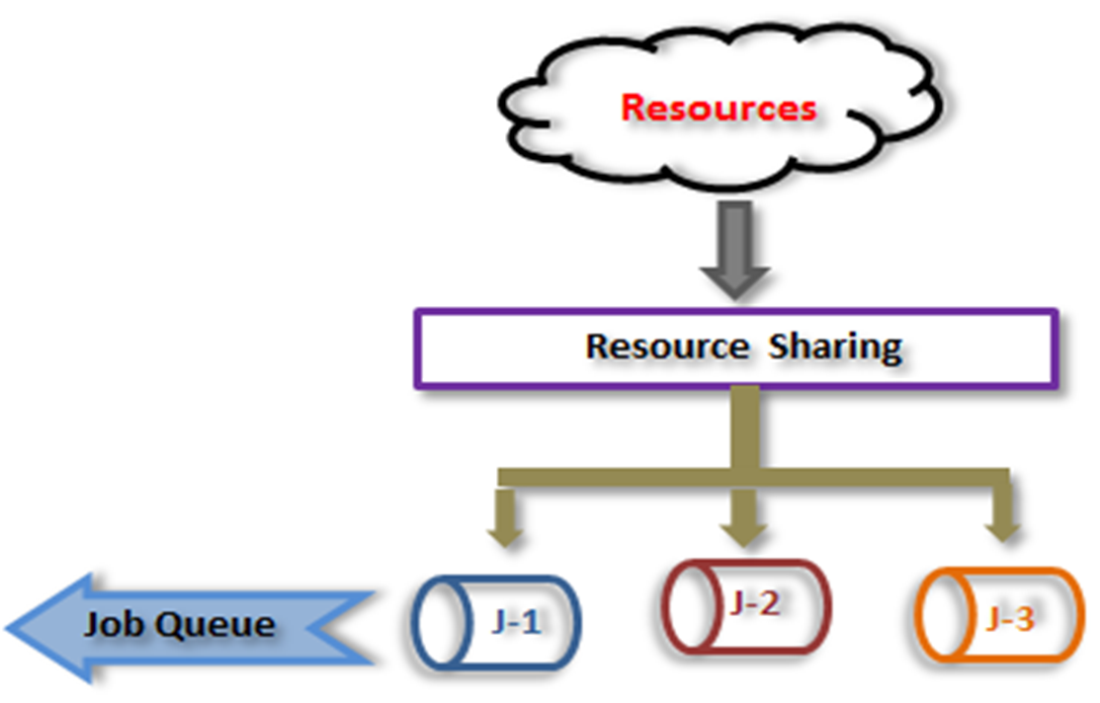
Fair Scheduler
Fair scheduler – Fairly Share Resources to Jobs .
Each job gets equal share of available resources over a time.
Not useful when order of execution is important.
Small size jobs executes faster than large size jobs.

Slide 8
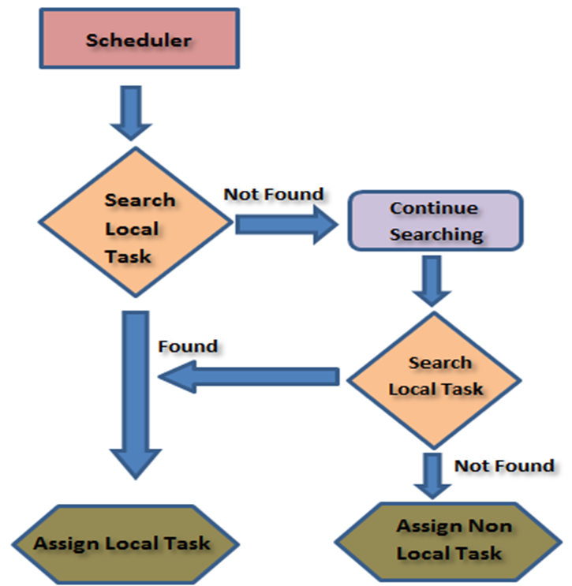
Matchmaking Scheduler
Matchmaking – Find Match.
Every slave node gets fair chance to grab local task.
Waste of Computing Resources.
Data Locality.

Slide 9
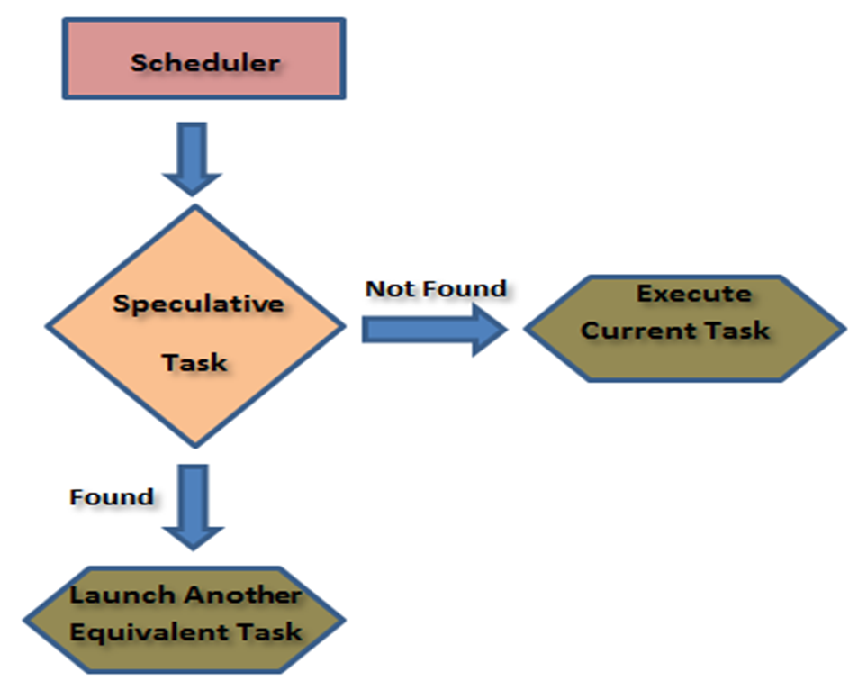
Longest Approximate Time To End (LATE)
LATE – Detects Speculative Tasks.
Speculative tasks are those tasks that progress very slowly.
Works well on homogeneous clusters but not on the heterogeneous cluster.
Minimize job Response Time.

Slide 10
Resource Aware Scheduler
RAS – Focuses on resource utilization.
Resource Metrics:
Dynamic Free slot Advertisement
Free slot priority/Filtering
Fairness

Slide 11
Conclusion
Local data processing takes lesser time as compared to moving the data across network. So to improve the performance of jobs, most of the algorithms work to improve the data locality.
Work load must be fairly distributed to achieve good performance.
To meet the user expectations, scheduling algorithms must use prediction methods based on the volume of data to be processed and underlying hardware. So as a future work we can consider developing the algorithms which can schedule the jobs efficiently on heterogeneous clusters.

Slide 12
REFERENCES
M. Zaharia, A. Konwinski, A. D. Joseph, R. Katz, and I. Stoica, “Improving mapreduce performance in heterogeneous environments,” (2008) in 8th Usenix Symposium on Operating Systems Design and Implementation, (New York), pp. 29–42, ACM Press.
Quan Chen; Daqiang Zhang; Minyi Guo; Qianni Deng; Song Guo; , "SAMR: A Self-adaptive MapReduce Scheduling Algorithm in Heterogeneous Environment,"(2010) Computer and Information Technology (CIT), 2010 IEEE 10th International Conference on , vol., no., pp.2736-2743.
Houvik B Ardhan, Daniel A. Menasce. “The Anatomy of MapReduce Jobs, Scheduling, and Performance Challenges”, Proceedings of the 2013 Conference of the Computer Measurement Group, San Diego, CA, November 5-8, 2013.
“ Apache Hadoop.” http://hadoop.apache.org.
R. Nanduri, N. Maheshwari, A. Reddyraja, and V. Varma, “Job aware scheduling algorithm for mapreduce framework,”(2011) in Proceedings of the 3rd International Conference on Cloud Computing Technology and Science, CLOUDCOM ’11, (Washington, DC, USA), pp. 724–729, IEEE Computer Society.

Slide 13
Thank you..

